Slide 1
Analysing Survey Data with R Using Yale University Climate Change and the American Mind project
David Houle, Ph.D.

Slide 2
What is R? A metaphore

Slide 3
Solution offered by most Statistical Software package (SPSS, STATA, Excel, etc.): take the bus (it get most people where they need to be although not always by the most direct route)

Slide 4
R solution: build your own car!

Slide 5
Why R?
R is flexible and powerful programmation language, used in a vast multitude of software (packages)—more or less sophisticated software that will allow you to get where you need to go.
Useful package to produce graphes from Survey data are:
GGPLOT2 (general and popular package to generate graphics)
LIKERT (highly specialized package for making graphics with survey data using Likert scale)
R allows your research to be reproducible (by sharing dataset and codes)

Slide 6
What is special about survey data?
Survey data usually used categorical variables?
Ex. How much do you like unicorn? (refused, don’t know, not at all, only a little, a moderate amount, a great deal)
Respondent_ID | Q1 | Q2 | Q3 | Q4 | Q5 | Q6
1 | not at all | a moderate amount | a great deal | a moderate amount | don’t know | only a little
2 | a great deal | not at all | a great deal | A great deal | not at all | not at all
3 | a moderate amount | only a little | a great deal | refused | not at all | a great deal
4 | only a little | a moderate amount | a moderate amount | not at all | a great deal | not at all

Slide 7
What is a Likert scale?
A typical item in a Likert scale is a statement to which respondents rate their level of agreement. The statement may be positive or negative. Usually a five-point scale of agreement like the following is used:
1.Strongly disagree
2.Disagree
3.Neither agree nor disagree
4.Agree
5.Strongly agree
Source: Science Direct, 2019

Slide 8
Who Was Likert?
Dr. Rensis Likert was a sociogist at the University of Michigan best known for survey research methods and for the Likert scale; a psychometric scale commonly involved in research using questionnaires.
His original report entitled “A Technique for the Measurement of Attitudes” was published in the Archives of Psychology in 1932.
Pr. Likert’s name is pronounced “LICK-ert,” not “LIKE-ert.
Source: Science Direct, 2019

Slide 9
Climate Change in the American Mind project (1)
The Yale Program on Climate Change Communication (YPCCC) and the George Mason University Center for Climate Change Communication have conducted nationally representative surveys of U.S. adults twice a year.
The datasets include 17 waves of nationally representative surveys of U.S. adults aged 18 and older collected between 2008 and 2017.
Source: Yale Program on Climate Change Communication (YPCCC) and the George Mason University Center

Slide 10
Climate Change and the American Mind project (2)

Slide 11
Your data is only available in SPSS format!!!!
WHY???

Slide 12
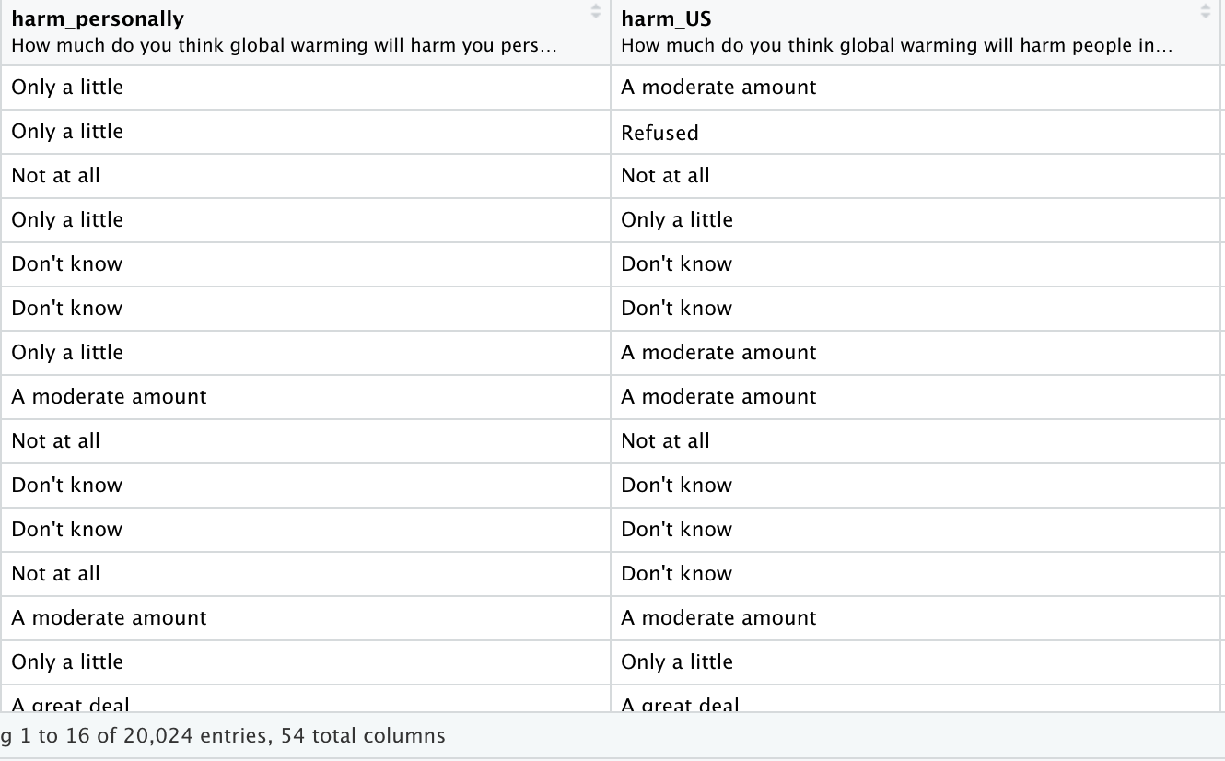
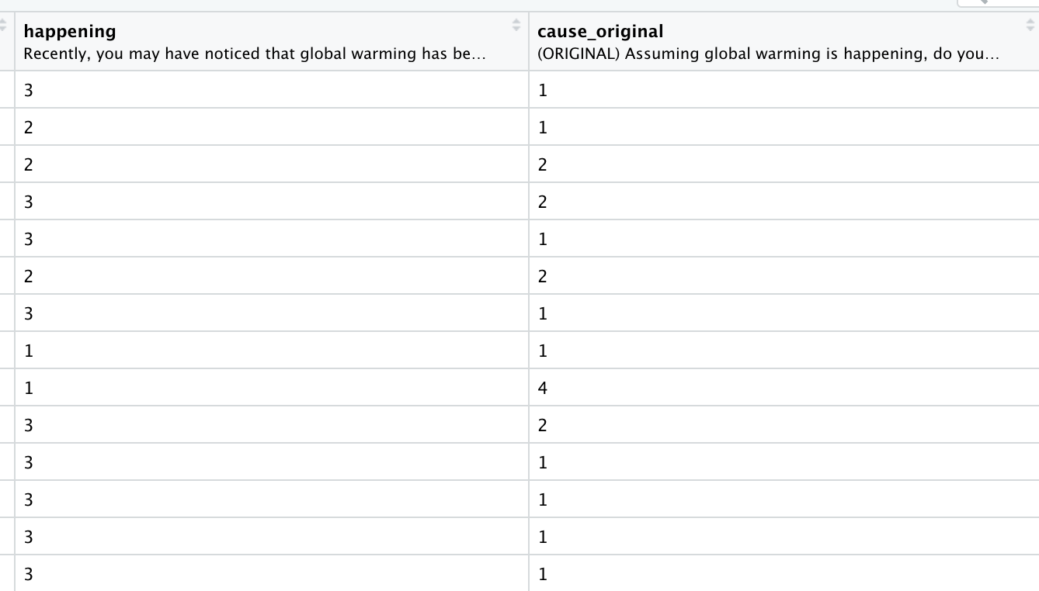
Climate Change and the American Mind project (3) What the data looks like?
Step 1

Slide 13
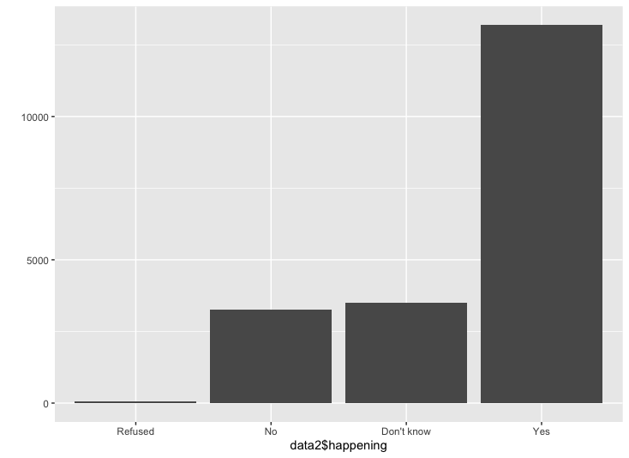
Climate Change and the American Mind project (4) Qplot by default ggplot2 graphs

Slide 14
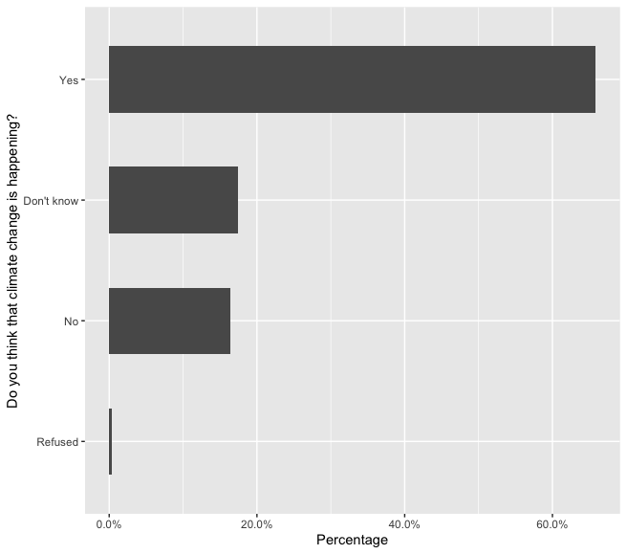
Using GGplot2 package (2/2)
R qplot by default graphs
p <- ggplot(data2, aes(happening)) + geom_bar(aes(y = (..count..)/sum(..count..)), width=0.55) + scale_y_continuous(labels=percent) +
ylab("Percentage") +
xlab("Do you think that climate change is happening?") +
coord_flip()

Slide 15
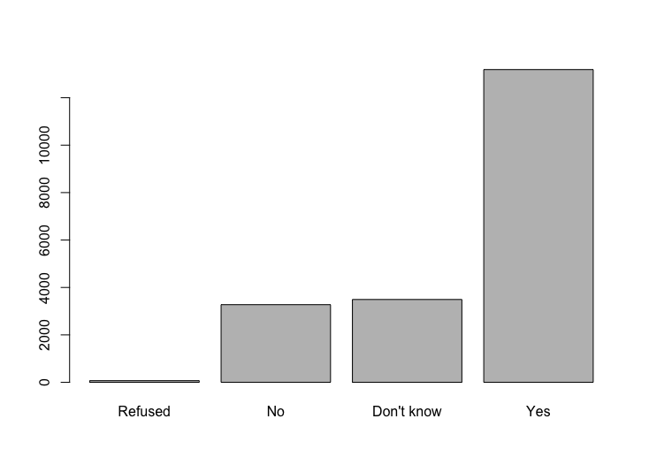
Using the Likert package (1/ )
Simple plot using the Likert package
Library(Likert)
plot(data2$happening)
Preparing data for more advanced graph:
df1<data.frame(data2$harm_US,data2$harm_personally,data2$harm_dev_countries,data2$harm_plants_animals,data2$harm_future_gen)
names(df1) <- c(
data2.harm_US = "Global warming will harm the US",
data2.harm_personally = "Global warming will harm me",
data2.harm_dev_countries = "Global warming will harm developing countries",
data2.harm_plants_animals = "Global warming will harm plants and animals",
data2.harm_future_gen = "Global warming will harm future generations")
str(df1)
, center=4,include.center=FALSE, wrap=30

Slide 16
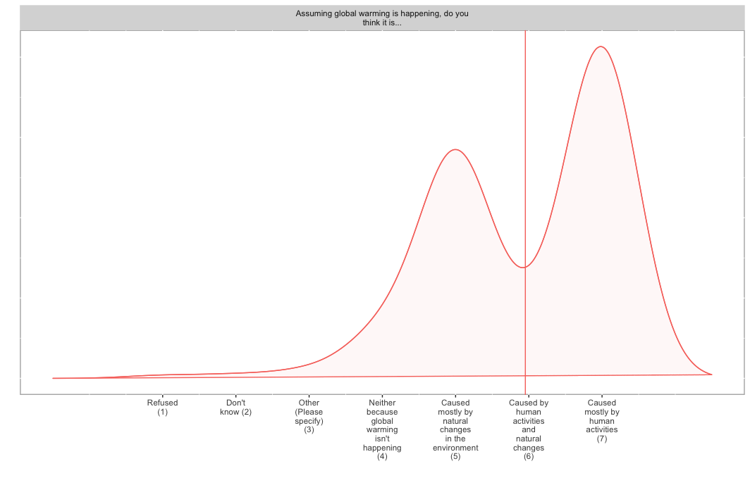

Slide 17
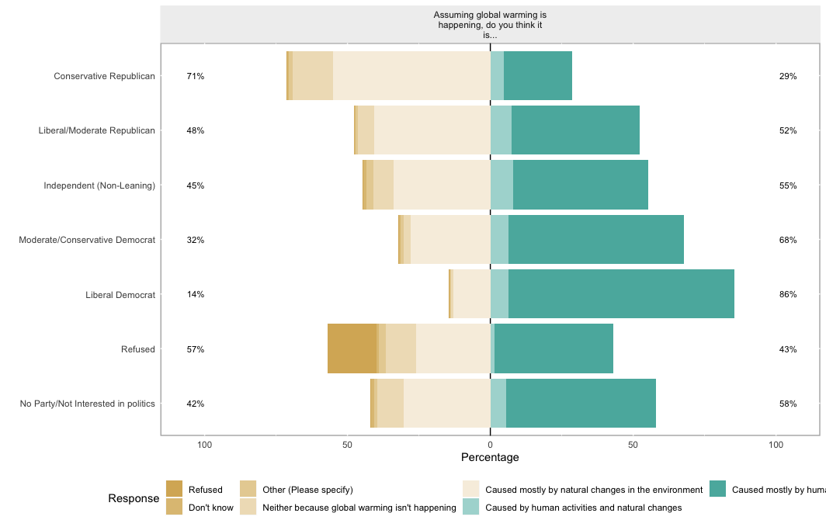

Slide 18
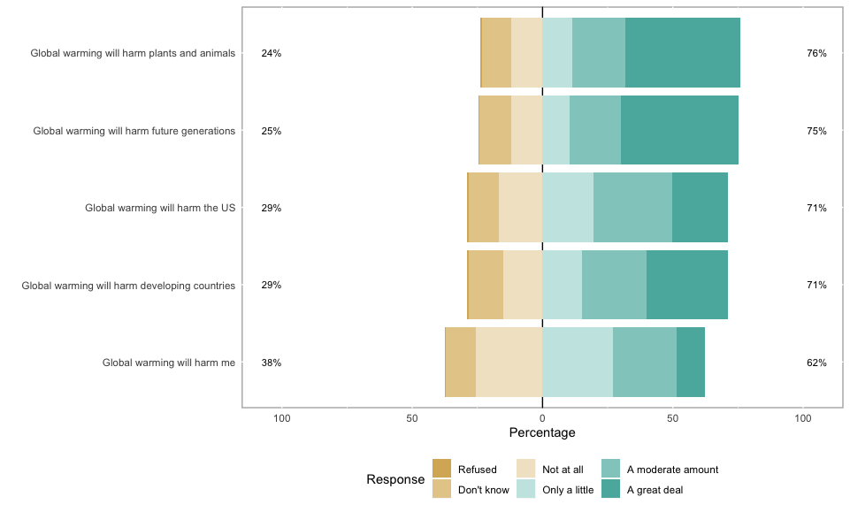
Using Likert package (2/
Stacked bar graph
str(df1)
l1<-likert(df1)
plot(l1)

Slide 19
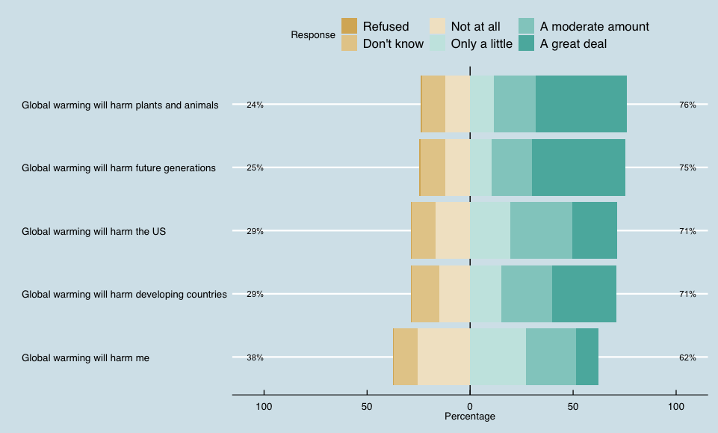
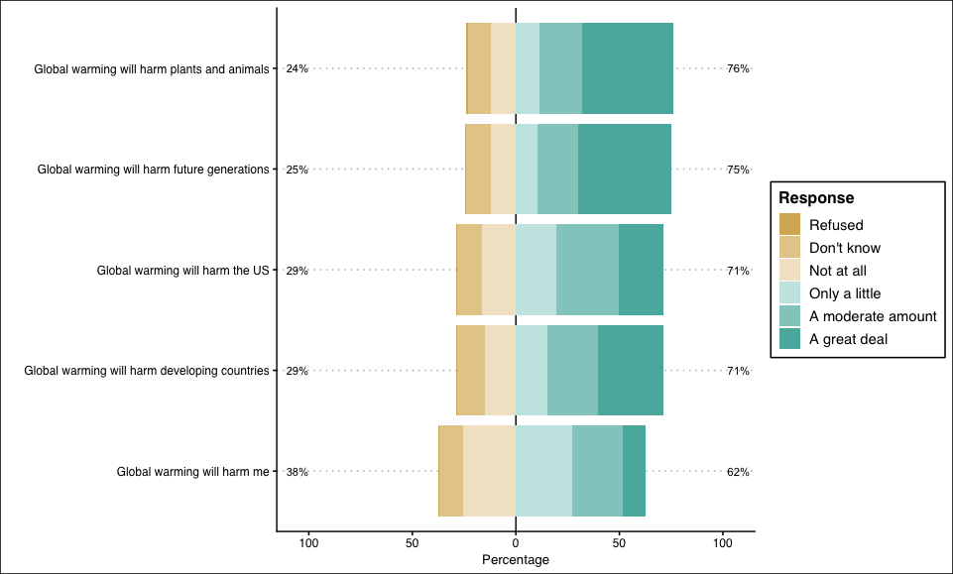
Using Likert+ggthemes

Slide 20
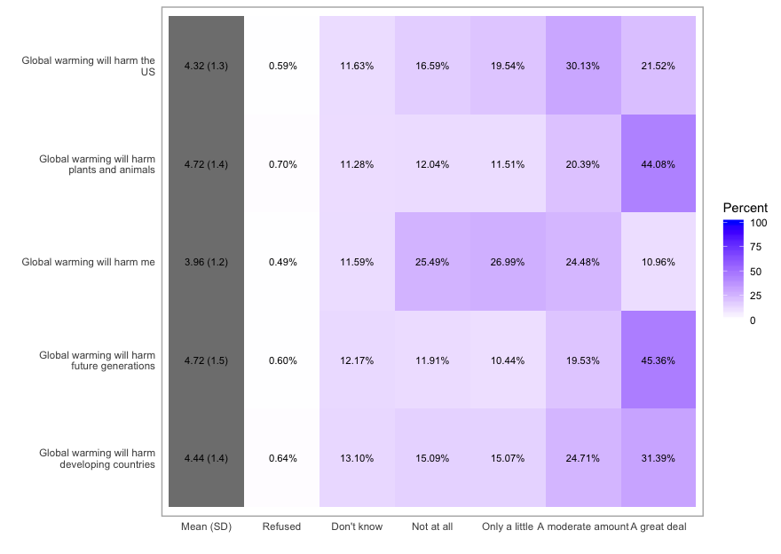
Using Likert package: heat map

Slide 21
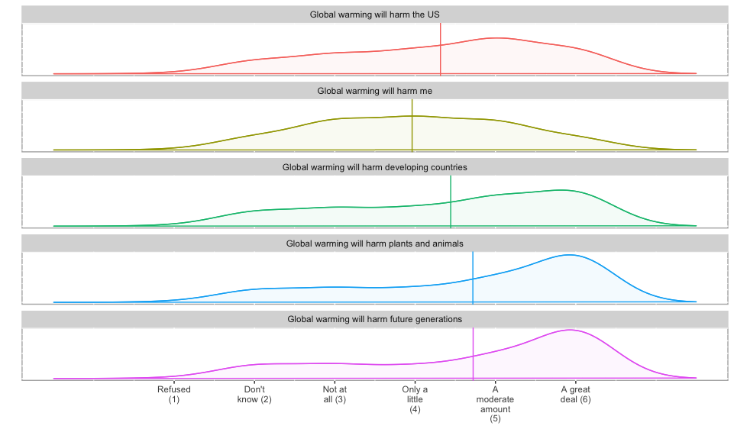
Using Likert package: density and lattices

Slide 22
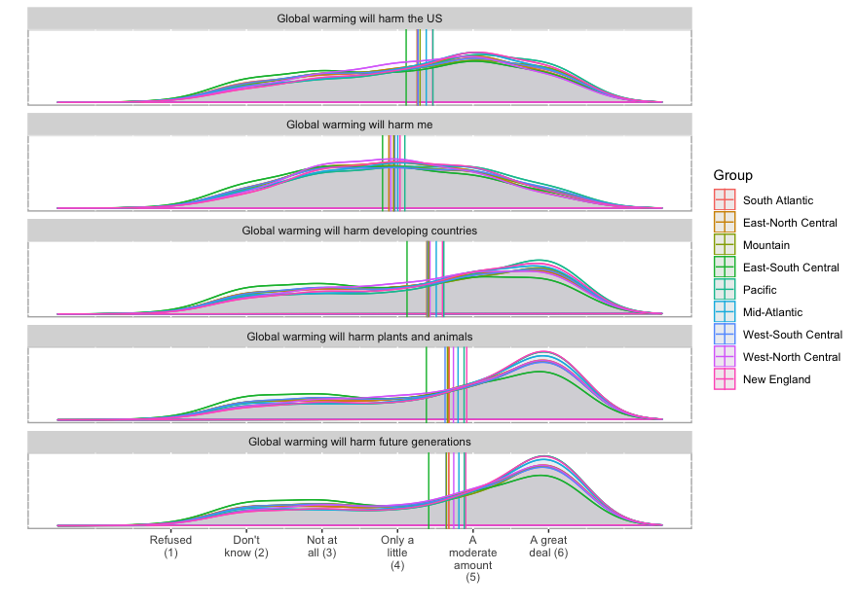

Slide 23
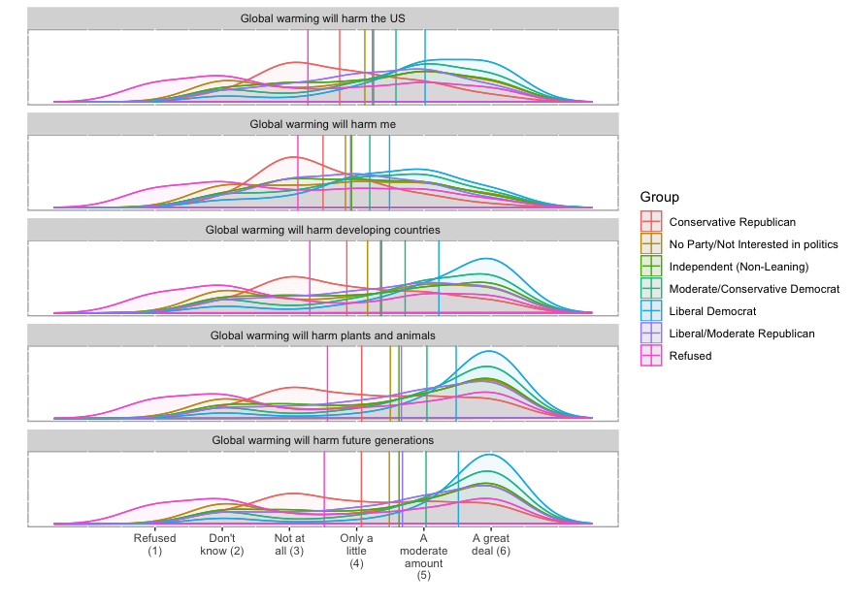

Slide 24
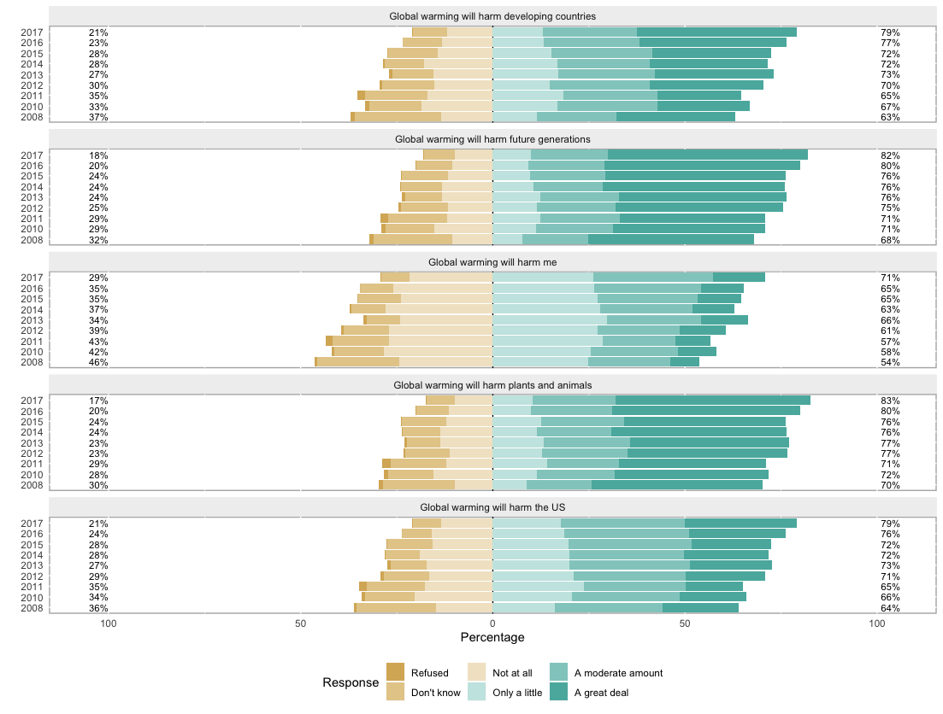
Using Likert package: Stacked plots and lattices (years)

Slide 25
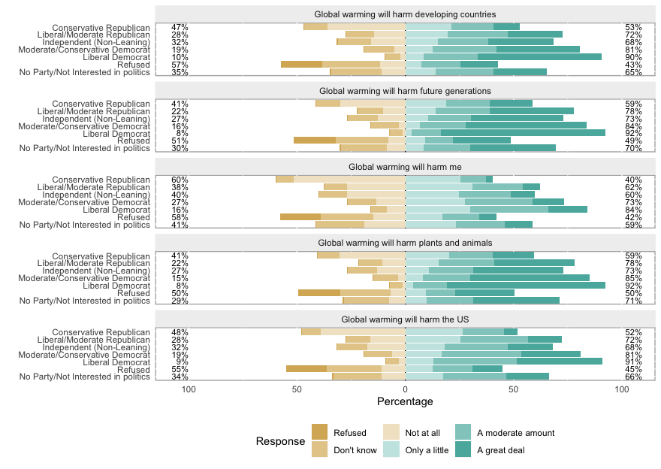
Using Likert package: Stacked plots and lattices (partyXideology)

Slide 26
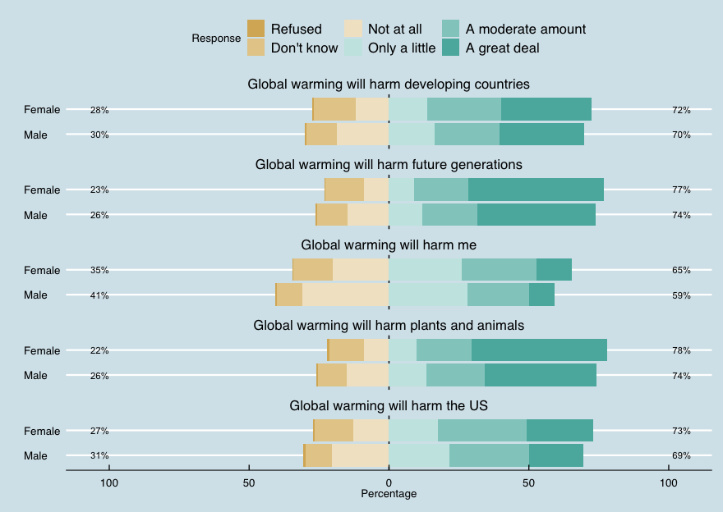
Gender (the economist style)

Slide 27
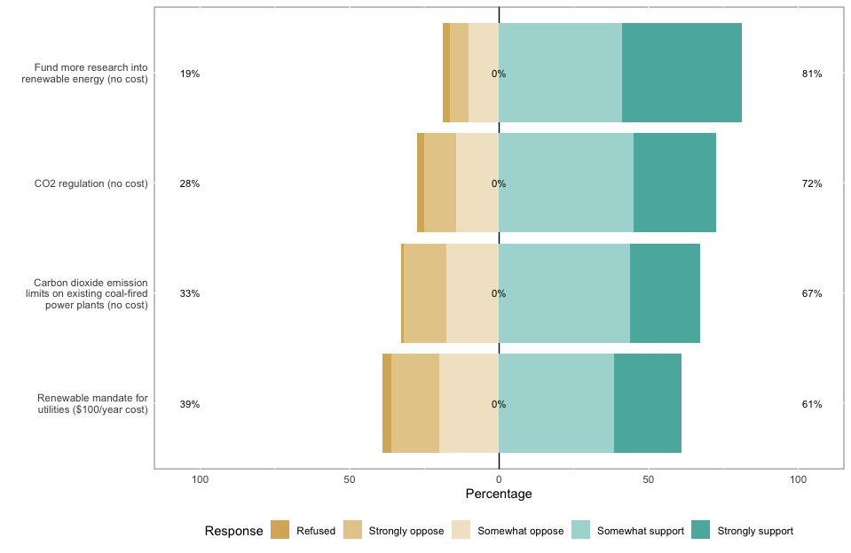
Support for climate policy

Slide 28
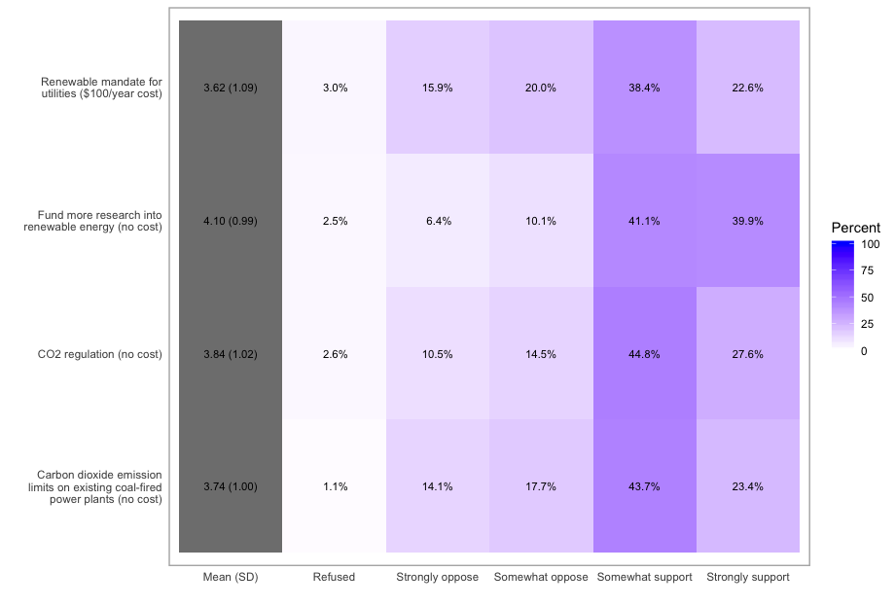
Support for climate policies, heat map

Slide 29
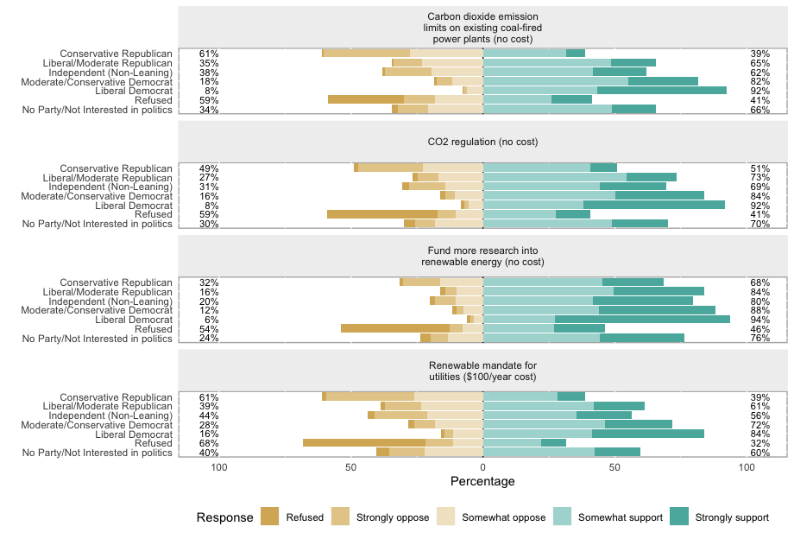

Slide 31
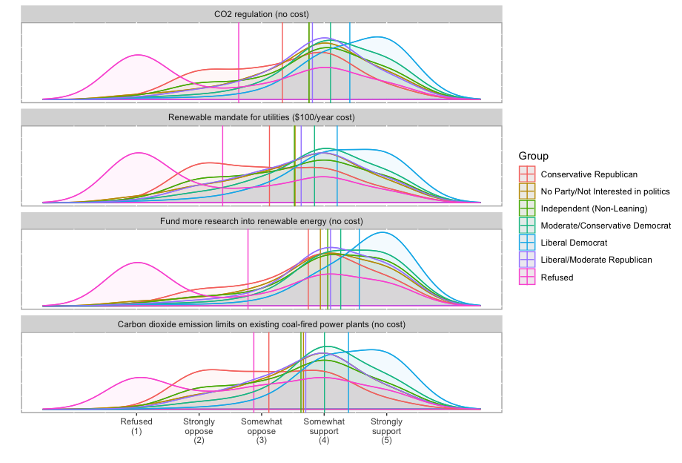

Slide 32
Ordinal logistics regression
m <- polr(happening ~ ideology, data=data2, Hess=TRUE)
Call: polr(formula = happening ~ ideology, data = data2, Hess = TRUE)
Ideology | Coefficients | Intercepts
Very liberal | 2.2423378
Somewhat liberal | 2.1472236
Moderate, middle of the road | 1.1074550
Somewhat conservative | 0.1617630
Very conservative | -0.7593255
Refused|No |  | -5.1574939
No|Don't know |  | -0.9363903
Don't know|Yes |  | 0.1656136
Residual Deviance |  |  | 32402.57
AIC |  |  | 32418.57

Slide 33
Code (1): Reading SPSS datasets
Library (haven)
data <- read_sav("data.sav")
data_backup <- data # data backup (just in case...)
data2<-as_factor(data, levels = "labels")

Slide 34
Code (2): Basic Graphes (with ggplot2)
library(ggplot2)
R qplot by default graphs
qplot(data2$happening)
p3 <- ggplot(data2, aes(happening)) +
geom_bar(aes(y = (..count..)/sum(..count..)), width=0.55) +
scale_y_continuous(labels=percent) +
ylab("Percentage") +
xlab("Do you think that climate change is happening?") +
coord_flip()
p3

Slide 35
Code (3): Stacked plot Perception of harm caused by climate change
df1<-data.frame(data2$harm_US, data2$harm_personally, data2$harm_dev_countries, data2$harm_plants_animals, data2$harm_future_gen)
names(df1) <- c(
data2.harm_US = "Global warming will harm the US",
data2.harm_personally = "Global warming will harm me",
data2.harm_dev_countries = "Global warming will harm developing countries",
data2.harm_plants_animals = "Global warming will harm plants and animals",
data2.harm_future_gen = "Global warming will harm future generations")
str(df1)
l1<-likert(df1)
plot(l1)

